Slide 1



PLANT SPECIES IDENTIFICATION FROM LEAF IMAGES

Slide 2


MADHAV KUMAR

Slide 3

OBJECTIVE
INTRODUCTION
LITERATURE SURVEY
ISSUES IN THE EXISTING SYSTEM
PROPOSED SYSTEM
IMPLEMENTATION AND RESULT
CONCLUSION
REFERENCE

Slide 4

INTRODUCTION
Plant species identification from leaf images using deep learning (DL) applications has emerged as a transformative tool in botany and computer vision. Deep learning techniques, particularly convolutional neural networks (CNNs), have demonstrated remarkable capabilities in discerning intricate patterns and features within images. These powerful models are trained on extensive datasets of leaf images, enabling them to learn the distinguishing characteristics of different plant species.
This innovative method holds great potential for automating and streamlining the process of plant identification, empowering researchers, botanists, and environmentalists to rapidly and accurately classify plants based on their leaf morphology. This technology not only expedites biodiversity studies and conservation efforts but also finds applications in agriculture, horticulture, and forestry. As DL models continue to advance, the accuracy and efficiency of plant species identification from leaf images are poised to revolutionize our understanding and management of plant ecosystems.

Slide 5

LITERATURE SURVEY
TITTLE | AUTHOR | PUBLISHED YEAR | METHODOLOGY
Plant Species Identification from Leaf Images Using Deep Learning Models (CNN-LSTM Architecture) | J. Banzi, T. Abayo | It is published in the year 2021. | LSTM layer in CNN to classify plant species, The main contribution of this work is the integration of LSTM on top of the CNN network for effective feature learning. It helps to selectively weight the features at different layers at the inception of a single layer.

Slide 6

TITLE | AUTHOR | PUBLISHED YEAR | METHODOLOGY
Plant Species Identification based on Plant Leaf Using Computer Vision and Machine Learning Techniques. | Surleen Kaur1 , Prabhpreet Kaur2 | It is published in the year 2019. | The system was tested on Swedish dataset and attained an average accuracy of 93.26%. The model could automatically classify 15 different plant Species by using SVM classifier.

Slide 7
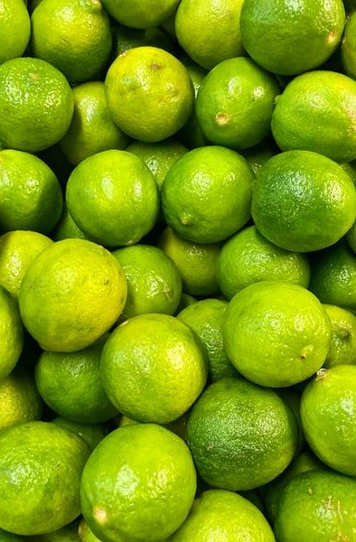
TITLE | AUTHOR | PUBLISHED YEAR | METHODOLOGY
Plant Species Identification Using Leaf Image Retrieval. | arlos Caballero , m. Carmen Aranda | It is published in the year 2010. | it has been developed a CBIR system applied to botany. This has been achieved by using two types of descriptors: geometrical and contour. The use of geometrical descriptors In this case an important attribute was the new factor added to the characteristic points: lifetime.

Slide 8

TITLE | AUTHOR | PUBLISHED YEAR | METHODOLOGY
Leafsnap: A Computer Vision System for Automatic Plant Species Identification | Neeraj Kumar1, Peter N. Belhumeur2, Arijit Biswas3, David W. Jacobs3, W. John Kress4, Ida C. Lopez4, and Jo˜ao V.B. Soares3 | It is published in the year 2017. | We describe the first mobile app for identifying plant species using automatic visual recognition. The system – called Leafsnap – iden- tifies tree species from photographs of their leaves. Identifying the species from a dataset of the 184 trees in the Northeastern United States.

Slide 9
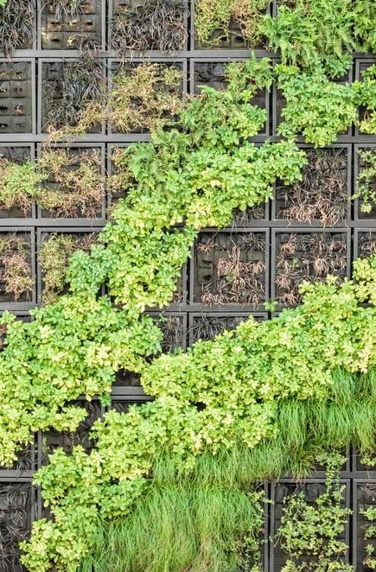
TITLE | AUTHOR | PUBLISHED YEAR | METHODOLOGY
Plant Species Identification from Occluded Leaf Images. | Ayan Chaudhury, John L. Barron | It is published in the year 2018. | We present an approach to identify the plant species from the contour information from occluded leaf image using a database of full plant leaves. Matching an occluded contour with all the full contours in a database is an NP-hard problem, so our algorithm is necessarily suboptimal. We show that our algorithm can, even for leaves with a high amounts of occlusion still identify the best full leaf match from the databases.

Slide 10
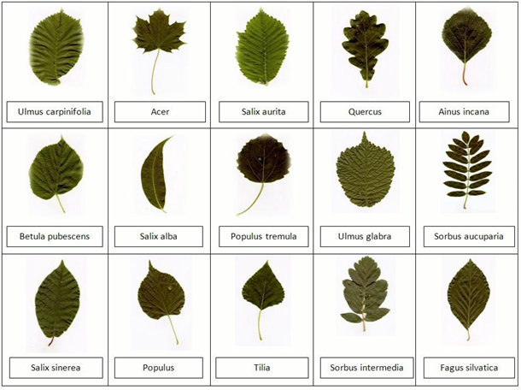
Overcoming Challenges
Leaf classification is considered a fine-grained image recognition problem and hard to solve due to the subtle differences between species in the same class. Sometimes, such fine differences can be even challenging to human experts. Adding on, this requires large training data per class, but it is not feasible due to the numerous species.
Swedish Leaf Dataset

Slide 11


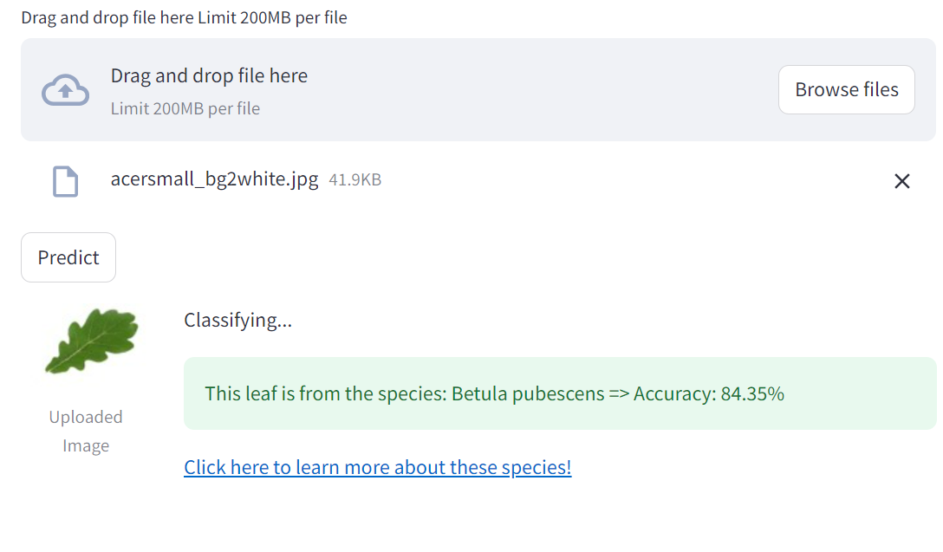
Output Screenshots

Slide 12

EXISTING METHODOLOGY
Traditional approaches to plant species identification from leaf images rely on manual feature extraction and classification techniques, using handcrafted features like shape, texture, and color descriptors. These methods face limitations in accuracy, robustness, and scalability, motivating the exploration of deep learning-based approaches. And this model predicted only classified leaf image.

Slide 13
PROPOSED METHODOLOGY
The proposed methodology utilizing deep learning techniques provides a promising solution for accurate and efficient plant species identification from leaf images. By leveraging the power of CNNs to automatically extract and learn discriminative features, this approach can significantly improve the performance of automated plant identification systems and contribute to various applications in biodiversity conservation, ecological research, and agricultural management.

Slide 14
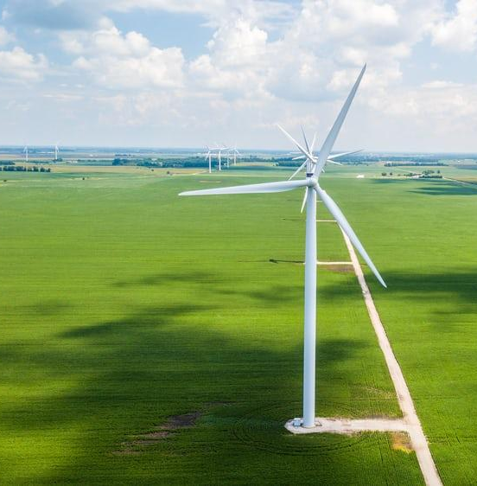

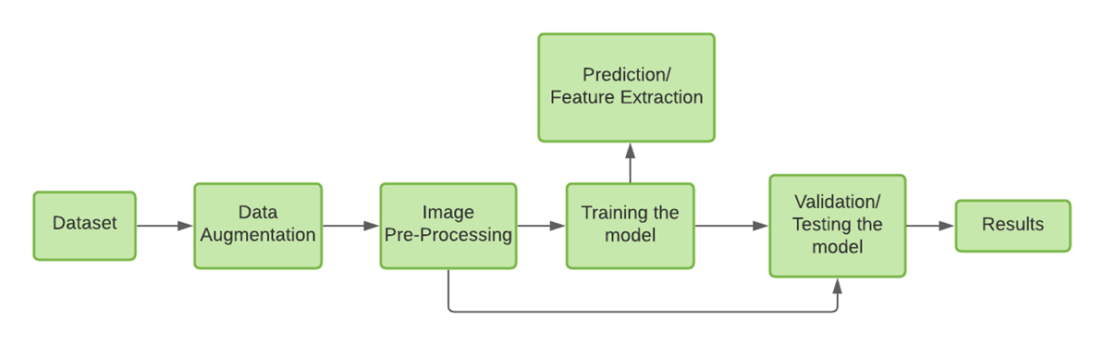
Approach and Training Methods
There is no single feature extraction technique that can be considered as the best method since different problems require different approaches and different mechanisms.
Classifier | Advantages | Disadvantages
Artificial Neural Network (ANN) | 1. Capable of distinguishing complex nonlinear relationships between independent and dependent variables. 2. Simplistic statistical training. | 1. Great tendency of data overfitting. 2. Bigger computational load.
Convolutional Neural Network (CNN) | 1. Multiple features can be extracted simultaneously. 2. Robust to noise. | 1. High computation level. 2. Incapable of generalization.

Slide 15
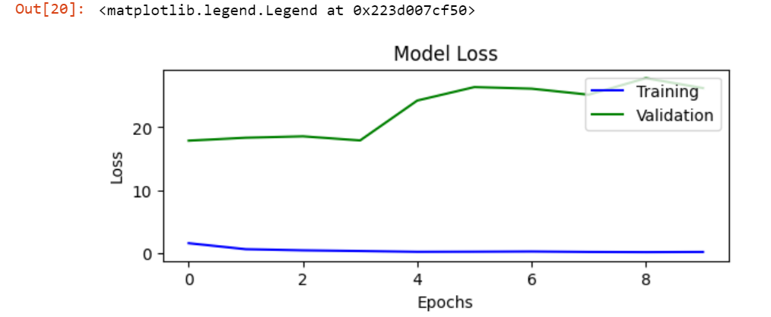
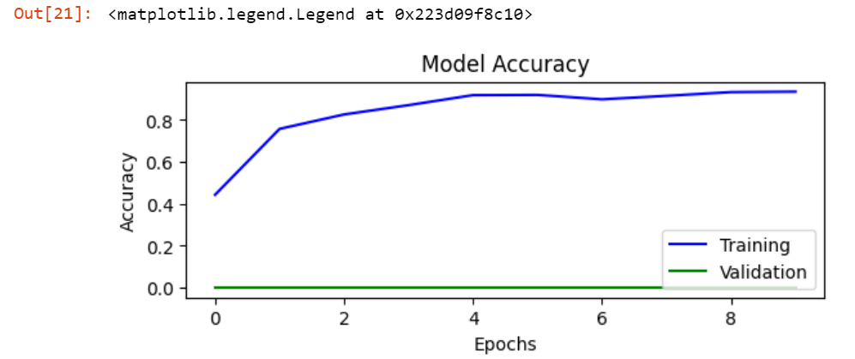
Analyzing results:
20% of our images from the dataset are saved for validation.
Our model brings us a validation accuracy of 96.8% towards the end of training of all the epochs.
On observation, the graphs are not completely monotonic and this can be mainly related to the overfitting of data.
However, both graphs do recover and we can see the validation loss approaches an all-time low.

Slide 16
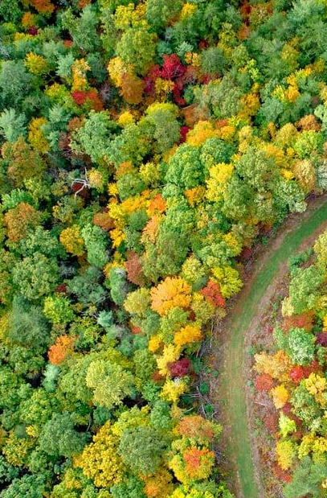
CONCLUSION
In conclusion, employing Deep Learning (DL) for plant species identification from leaf images represents a cutting-edge and effective approach. Leveraging Convolutional Neural Networks (CNNs) on well-curated datasets enables the model to discern intricate patterns and features specific to various plant species. However, success hinges on quality data, preprocessing, and model selection. Continuous refinement and staying updated are crucial for sustained accuracy. This method has transformative potential for agriculture, ecology, and conservation efforts.

Slide 17

REFERENCES
1.Altieri, M.A. Agroecology: The Science of Sustainable Agriculture; CRC Press: Boca Raton, FL, USA, 2018.
2. Gebbers, R.; Adamchuk, V.I. Precision agriculture and food security. Science 2010, 327, 828–831. [CrossRef] [PubMed] 3. Carvalho, F.P. Agriculture, pesticides, food security and food safety. Environ. Sci. Policy 2006, 9, 685–692. [CrossRef] 4. Mohanty, S.P.; Hughes, D.P.; Salathé, M. Using deep learning for image-based plant disease detection. Front. Plant Sci. 2016, 7, 1419. [CrossRef] [PubMed] 5. Miller, S.A.; Beed, F.D.; Harmon, C.L. Plant disease diagnostic capabilities and networks. Annu. Rev. Phytopathol. 2009, 47, 15–38. [CrossRef] 6. LeCun, Y.; Bengio, Y.; Hinton, G. Deep learning. Nature 2015, 521, 436–444. [CrossRef]
7. Najafabadi, M.M.; Villanustre, F.; Khoshgoftaar, T.M.; Seliya, N.; Wald, R.; Muharemagic, E. Deep learning applications and challenges in big data analytics. J. Big Data 2015, 2, 1–21. [CrossRef] 8. Szegedy, C.; Liu, W.; Jia, Y.; Sermanet, P.; Reed, S.; Anguelov, D.; Erhan, D.; Vanhoucke, V.; Rabinovich, A. Going deeper with convolutions. In Proceedings of the IEEE Conference on Computer Vision and Pattern Recognition, Boston, MA, USA, 7–12 June 2015; pp.

Slide 18


